Slide 1
HUMILITY
By: Zenas the Lawyer

Slide 2
Character Council of Greater Cincinnati and Northern Kentucky
www.charactercincinnati.org

Slide 3
Character Council of Greater Cincinnati and Northern Kentucky
Humility (vs. Arrogance)
Acknowledging that achievement
results from the investment
of others in my life

Slide 4
HUMILITY
Humility ……… the quality or state of not thinking you are better than other people
http://www.merriam-webster.com/dictionary/humility

Slide 5
Character Council of Greater Cincinnati and Northern Kentucky
How to Practice Humility,
praise my parents, teachers, teammates and coaches
not think more highly of myself than I ought
take responsibility for all my actions
try again after each defeat
give credit to those who have made me successful

Slide 6
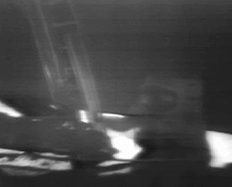

Slide 7
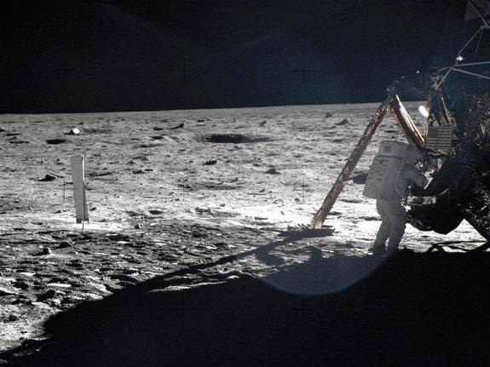

Slide 8
"That's one small step for man, one giant leap for mankind."
Neil Armstrong
Notes:
Currently, he is a producer of an educational TV Show program- The Hour of Empowerment- that provides personal development, civic education, organizational, and leadership development programs. Assegid is also the founder of PRO Leadership Global Inc., an organization that promotes leadership as the birth right of all. He is also the author of “Redefining Leadership: Navigating the Path from Birthright to Fulfillment in Life!”
(less)

Slide 9
THIS WEEK IN THE NEWS
NASA, Apollo 11 crewmates honor Neil Armstrong 45 years after moon landing
Notes:
Apollo 11 moonwalker Buzz Aldrin, command module pilot Mike Collins and Apollo 13 commander Jim Lovell joined NASA dignitaries and Neil Armstrong's family Monday to rename the historic Operations and Checkout Building at the Kennedy Space Center in honor of the first man to walk on the moon.

Slide 10
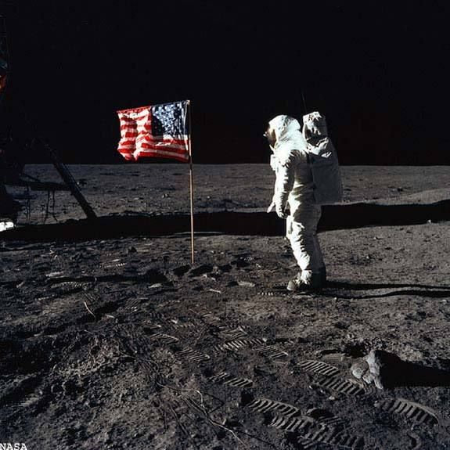

Slide 11
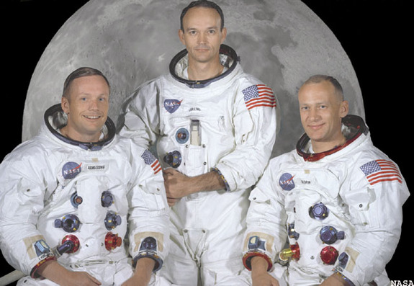
Notes:
APE CANAVERAL, Fla. — Lots of kids build model airplanes, but how many also build a wind tunnel to test and improve their models?
Neil Armstrong did, and more than the "small step" on the moon that secured his place in history 45 years ago, that explains the kind of person he was, said Michael Collins, Armstrong's Apollo 11 crewmate along with Buzz Aldrin.
"That powerful, powerful combination of curiosity and intelligence propelled him to the top of his profession," Collins said today at Kennedy Space Center. "Over and over again he took it one step further, and that eventually brought him to the last rung on the ladder of the Apollo 11 (lunar module)."
Collins, Aldrin and family members of the late Armstrong, who died in 2012 at age 82, were among dignitaries who addressed roughly 500 guests during a ceremony formally naming a historic KSC facility after the first moonwalker.
Though Armstrong would not have sought the honor, they said, it was appropriate for his name to grace the Operations and Checkout Building, where thousands worked behind the scenes to prepare Apollo spacecraft for flight and where astronauts spent months training for their missions.
USATODAY
Apollo 11 anniversary: 'One giant leap for mankind'
"Neil never capitalized on his celebrity," said Jim Lovell, Armstrong's backup commander for Apollo 11. "He always felt that he was part of a team of thousands of people working together to honor President Kennedy's commitment."
Inside the renovated "O&C" high bay that housed the ceremony, a smaller team now is working on a spacecraft NASA says will lead to its "next giant leap," to an asteroid in the mid-2020s and some day Mars.
The Orion capsule is being prepared for a first test flight in space later this year, without a crew.
In a move symbolically linking the Apollo program's achievement with planned future exploration, Administrator Charlie Bolden gave KSC Director Bob Cabana a framed mission patch that flew to the moon.
The Apollo 11 crew gave the patch to NASA in 1987 with an inscription that it should be presented to the first Mars-bound crew – a mission the agency hopes to launch from KSC, possibly in the 2030s.
"That is just unbelievably cool," Cabana said.

Slide 12
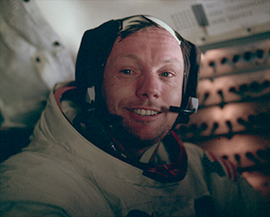

Slide 13
HUMILITY
"It suddenly struck me that that tiny pea, pretty and blue, was the Earth. I put up my thumb and shut one eye, and my thumb blotted out the planet Earth. I didn't feel like a giant. I felt very, very small."
Neil Armstrong

Slide 14
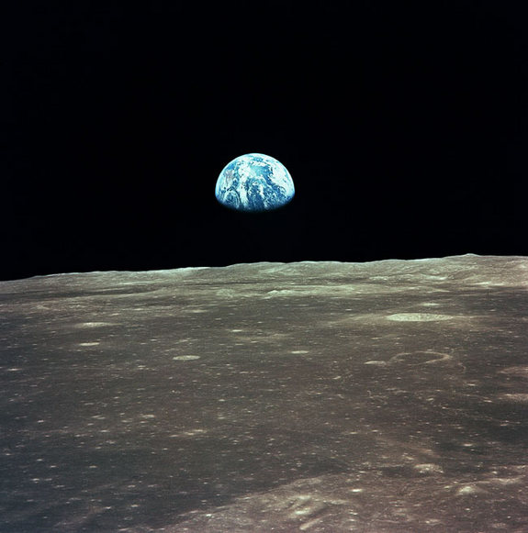

Slide 15
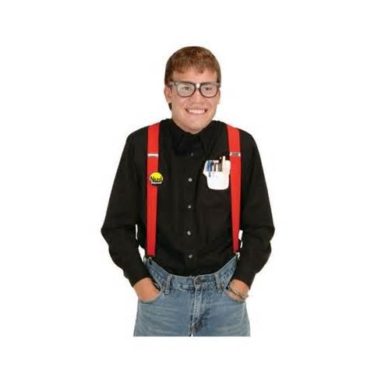
HUMILITY
"I am, and ever will be, a white socks, pocket protector, nerdy engineer."
Neil Armstrong

Slide 16
Bible Notes
“For those who exalt themselves will be humbled, and those who humble themselves will be exalted.”
Matthew 23:12 (NIV)

Slide 17
Bible Notes
And whosoever shall exalt himself shall be abased; and he that shall humble himself shall be exalted.” (same Greek word)
Matthew 23:12 (KJV)

Slide 18
Bible Notes
The Greek word translated “humble” in Matthew 23:12 is tapeinoō.
tä-pā-no'-ō (taw-pie-naw’-ho)
From VINE’s Dictionary ----- Abase: signifies "to make low, bring low,"
(a) of bringing to the ground, making level, reducing to a plain, as in Luk 3:5; (b) metaphorically in the Active Voice, to bring to a humble condition, "to abase," 2Cr 11:7, and in the Passive, "to be abased," Phl 4:12; in Mat 23:12; Luk 14:11; 18:14, the AV has "shall be abased," the RV "shall be humbled." It is translated "humble yourselves" in the Middle Voice sense in Jam 4:10; 1Pe 5:6; "humble," in Mat 18:4; 2Cr 12:21 and Phl 2:8.

Slide 19
Bible Notes
“For by the grace given me I say to every one of you: Do not think of yourself more highly than you ought, but rather think of yourself with sober judgment, in accordance with the faith God has distributed to each of you.”
Romans12:3 (NIV)

Slide 20
Bible Notes
“Finally, all of you, be like-minded, be sympathetic, love one another, be compassionate and humble..”
1 Peter 3:8 (NIV)

Slide 21
Bible Notes
“As a prisoner for the Lord, then, I urge you to live a life worthy of the calling you have received. Be completely humble and gentle; be patient, bearing with one another in love. Make every effort to keep the unity of the Spirit through the bond of peace.”
Ephesians 4:1-3 (NIV)

Slide 22
Bible Notes
“All of you, clothe yourselves with humility towards one another, because, ‘God opposes the proud but shows favour to the humble.”
1 Peter 5:5 (NIV)

Slide 24
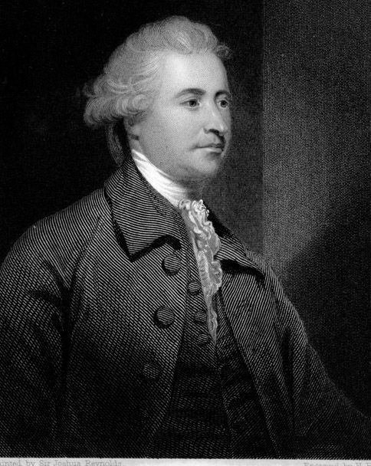
HUMILITY
“True humility—the basis of the Christian system—is the low but deep and firm foundation of all virtues."
Edmund Burke

Slide 25
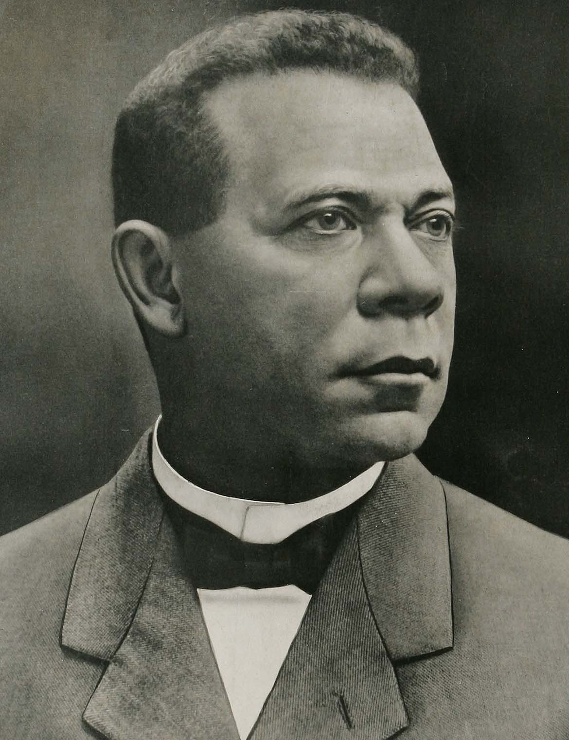
HUMILITY
“There are two ways of exerting one's strength: one is pushing down, the other is pulling up.”
Booker T. Washington

Slide 26
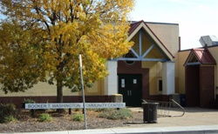
HUMILITY
“If you want to lift yourself up, lift up someone else.”
Booker T. Washington

